Slide 2
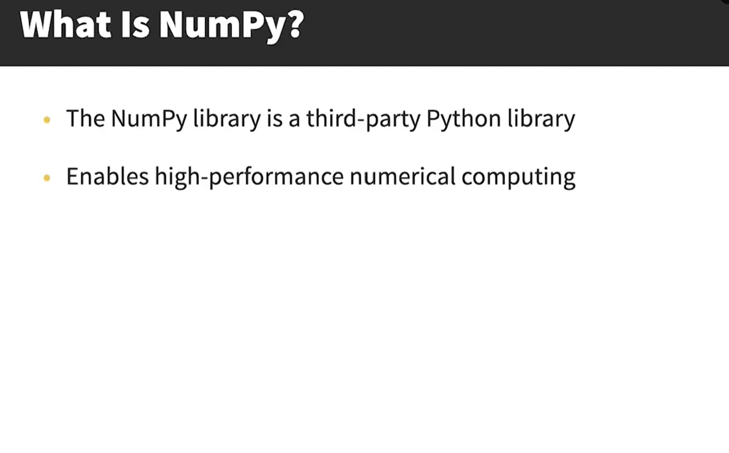
Can be used to shape and reshape data structures. Each of this
data-structure is called N-dimensional array or N-d array.

Slide 3
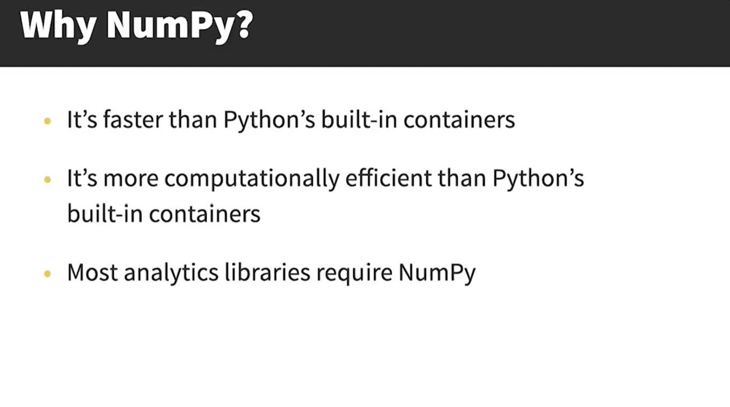
Or built on top of NumPy

Slide 4
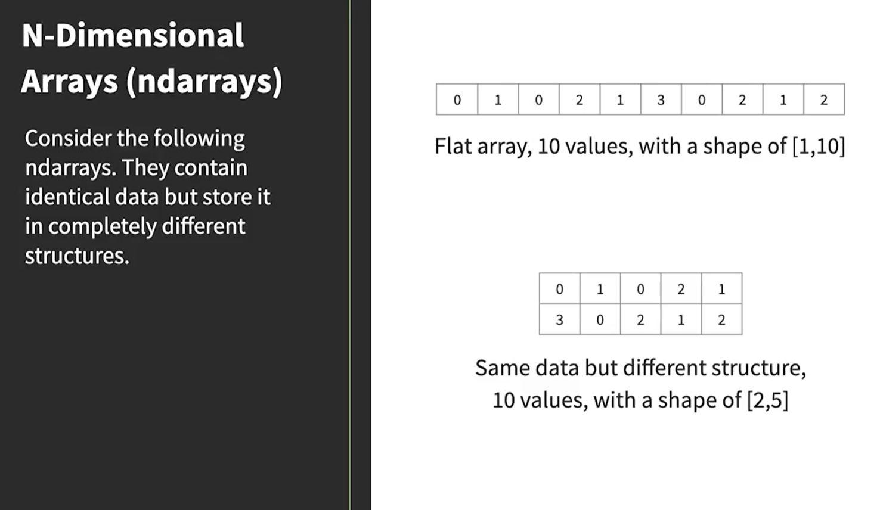
“ARRAY”
“MATRIX”

Slide 5
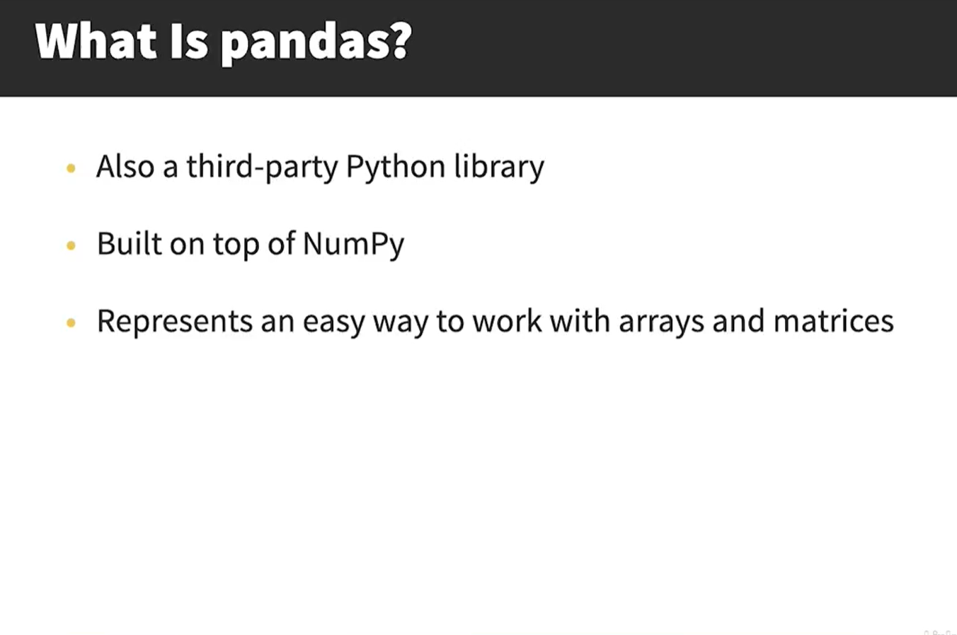

Slide 6
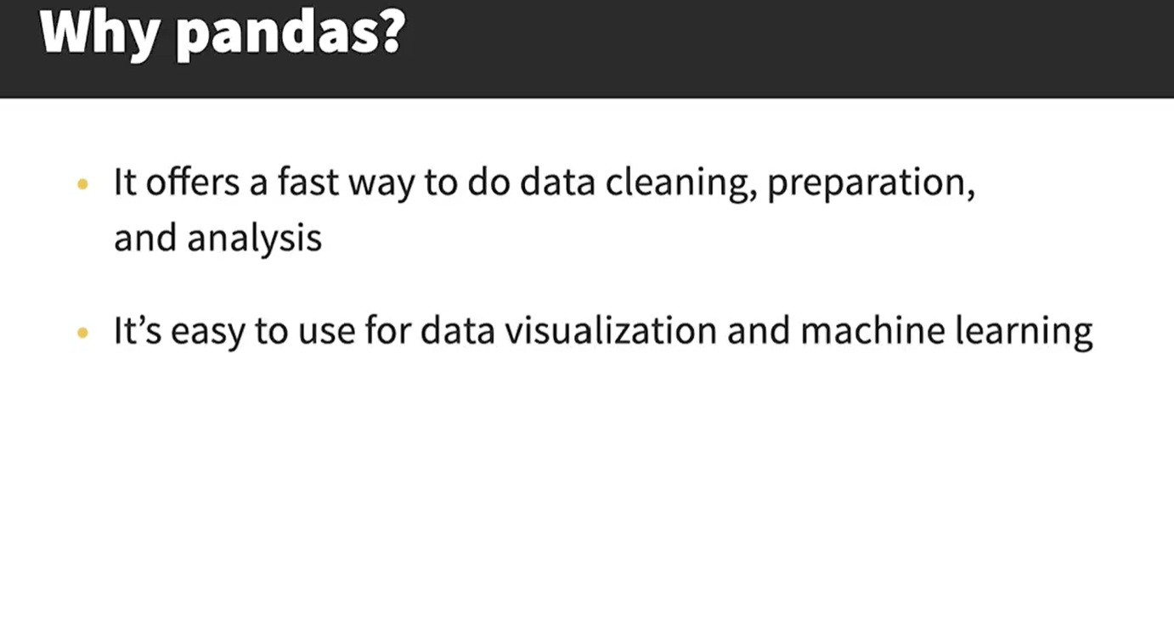

Slide 7
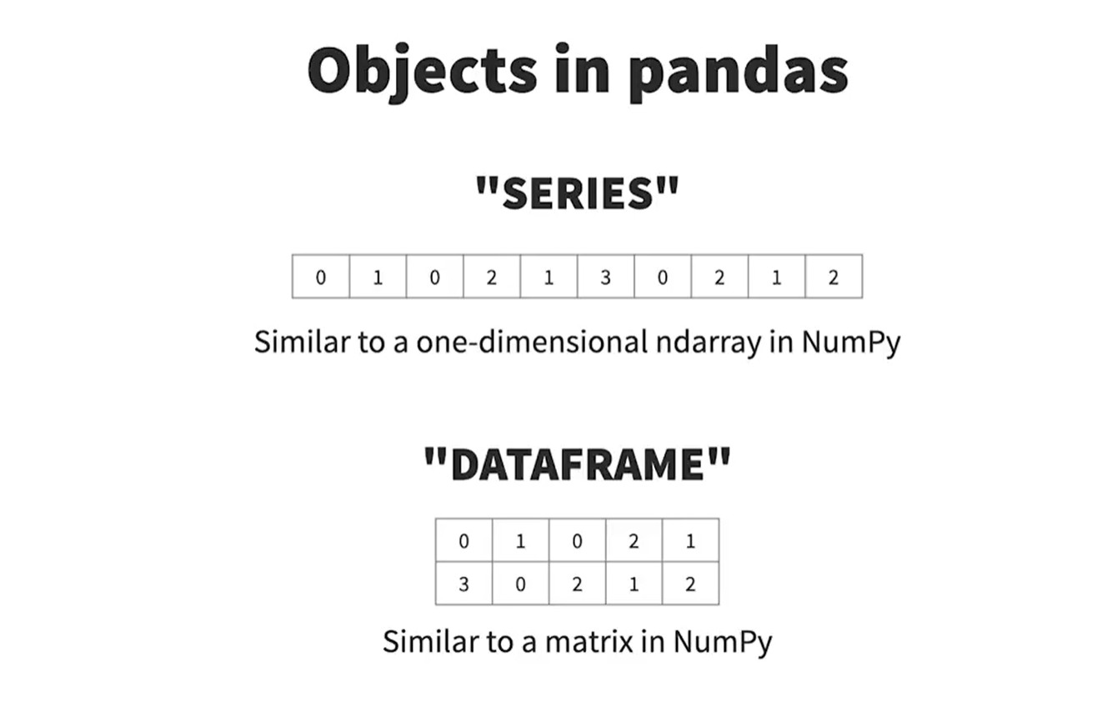
Series is one dimensional and Dataframe is two-dimensional table that
Can hold any type of data.

Slide 8
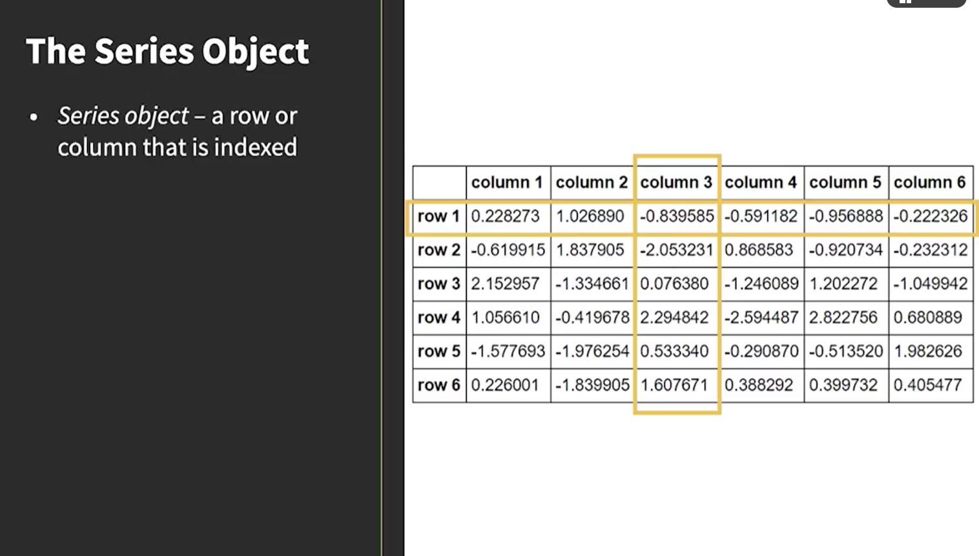

Slide 9
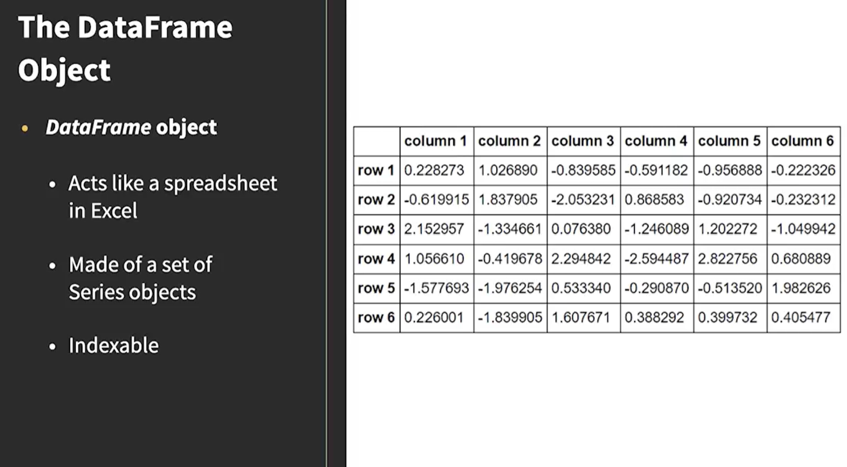

Slide 10
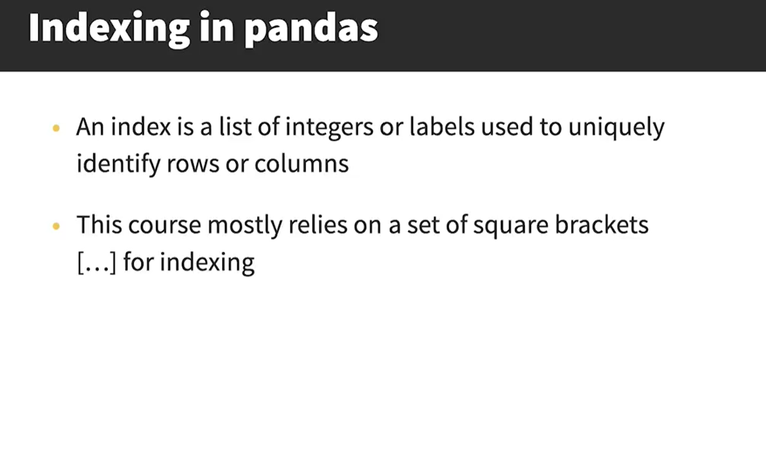

Slide 11
